Slide 1

Emotion Classification System using EEG signals for Non-Verbal Patients
CS 6220 Data Mining Techniques
Instructor: Mirek Riedewald
Team Members:
Henil Himanshukumar Patel (002058168)
Pavanchytanya Dharmapuri (002037438)
Deepashree Srinivasa Rao Rannore (002026701)
Vishal Kumar (002033054)

Slide 2

Overview and Problem Statement
Problem Statement
Non-verbal patients suffering from conditions such as locked-in syndrome or severe paralysis are unable to communicate their emotional state or physical discomfort
Taking their care becomes challenging for healthcare professionals and family members
The objective of this project is to classify emotions based on the EEG signals generated from a person’s brain based on stimulated response of surrounding into four derived categories from Valence and Arousal
Solution
An automated deep learning system that translates raw EEG brain signals into actionable emotional categories for caregivers
This provides healthcare professionals with insights into the patients’ emotional states
Data
Utilized the DEAP Dataset, consisting of 32-channel EEG recordings from 32 subjects
Task: To classify EEG segments into 4 Emotional States:
  Sad/Bored (Low Valence, Low Arousal) – Critical for distress detection.
  Angry/Fearful (Low Valence, High Arousal)
  Calm (High Valence, Low Arousal)
  Happy (High Valence, High Arousal)

Slide 3
Data Overview
Dataset Description
Dataset : DEAP (Emotion Detection)
Property | Value
Subjects | 32
Trials per subject | 40
Total Trials | 1280 (32 subjects X 40 trials)
EEG Channels | 32
Peripheral Channels | 8
Sampling Rate | 128 Hz
Trial Duration | 63 seconds
Labels | 4 Classes
32 EEG + 8 Peripheral Sensors
Dimension | Size
Trials | 40
Channels | 40
Time Points | 8,064 (-100 to +100 μV)
One rating per emotion
Dimension | Size
Trials | 40
Emotions | 4(rating range 1-9)

Slide 4
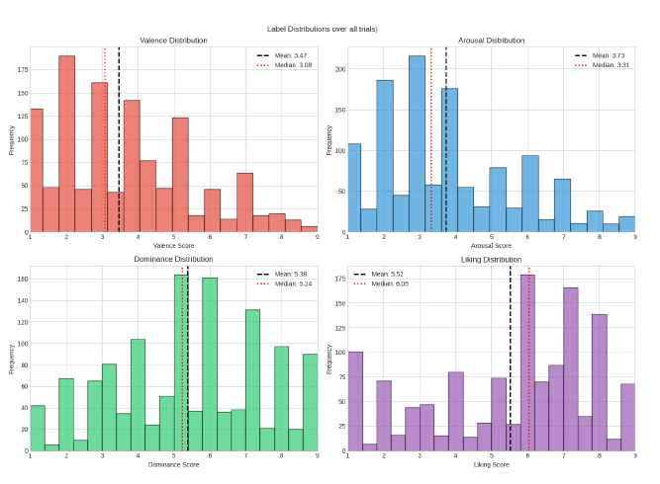
Exploratory Data Analysis
These histograms visualize the label distribution across all 1,280 trials for the four emotional dimensions (Valence, Arousal, Dominance, Liking)
We observed a significant left-skew in Valence and Arousal, meaning participants reported negative (low valence) and passive (low arousal) states
While the standard rating scale is 1–9 the data shows the actual center is much lower. Most data points fall well below 5.0
The median values for Valence (3.08) and Arousal (3.31) marked by the red dotted lines are significantly lower than the theoretical mean of 5.0
This confirms that applying a fixed threshold of 5.0 would incorrectly classify the majority of data into a single "Low-Low" partition, creating a massive class imbalance
Distribution of Valence, Arousal, Dominance, and Liking

Slide 5
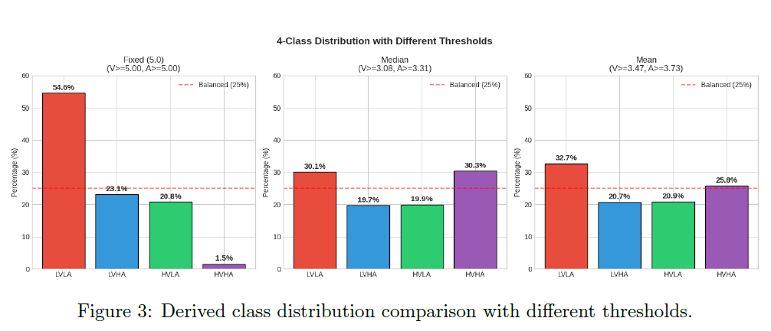
Smart Data Engineering: Solving Class Imbalance
Using standard rating threshold (5.0) created a severe class imbalance, with 54.6% of all data falling into a single category (Sad/Bored)
Instead of using the fixed scale, we calculated data-driven median thresholds specific to this dataset
This transformation successfully rebalanced the dataset, shifting from a skewed distribution to a nearly even ~25% split across all four emotional quadrants
By balancing the targets before training, we ensured the model learned distinct physiological features for each emotion rather than just biasing toward the majority class
Derived class distribution comparison with different thresholds

Slide 6
Model Architecture
Model Used: Multi-scale CNN + Gated Transformer + Temporal Convolution Network
Emotion Detection (32 channels from DEAP)
Multi-Scale CNN — Three parallel convolutional branches with kernel sizes of 16, 8, and 4 to capture temporal patterns at different scales
Spatial Convolution — Each CNN branch applies convolution across all 32 EEG channels to learn spatial relationships between brain regions
Regularization in CNN — Batch normalization, ELU activation, average pooling, and dropout (0.4) after each branch
Gated Transformer — 8-head self-attention with embedding dimension of 24 to capture long-range temporal dependencies
Feed-Forward Network — 2-layer FFN with hidden dimension of 96, plus layer normalization within the transformer
Temporal Convolutional Network (TCN) — Two dilated convolution layers with 32 filters for hierarchical temporal feature extraction (immediate + distant patterns)
Classification Head — Global average pooling followed by a linear classifier for 4-class output

Slide 7
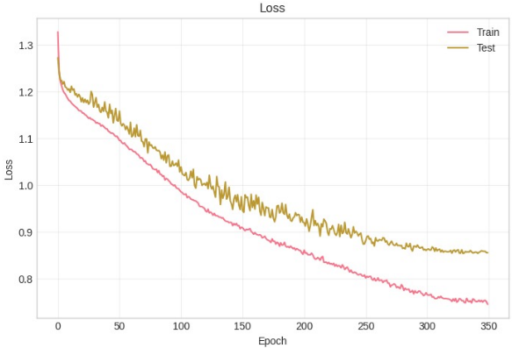
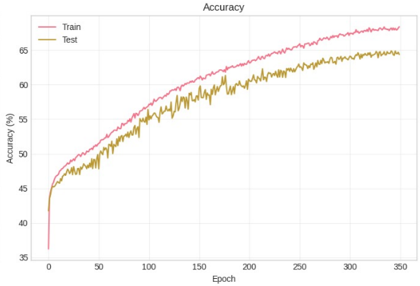
Results
The loss curves demonstrate a smooth, steady decline without significant oscillations or divergence, confirming that the model effectively minimized error and that our learning rate schedule was well-tuned
The training and test accuracy curves track closely together with only a small gap (~3.5%), indicating that our regularization techniques dropout and weight decay prevented overfitting despite the complex architecture
Both metrics stabilize near 350 epochs, achieving a peak test accuracy of 64.87%, which significantly outperforms the random baseline of 25% for this 4-class problem
These plots show that if we run more epochs then model can learn very well and the loss will decrease and accuracy will increase
Key Observations:
• Accuracy: 64.87%
• Precision: 65%
• Recall: 65%
• F1-Score: 64.5%

Slide 8
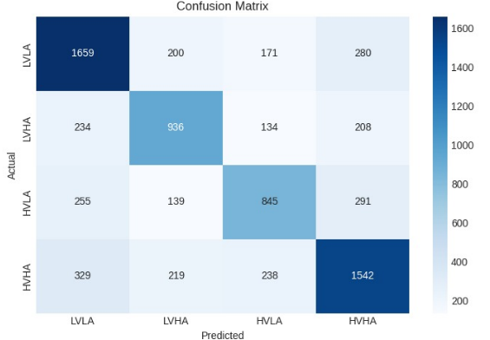
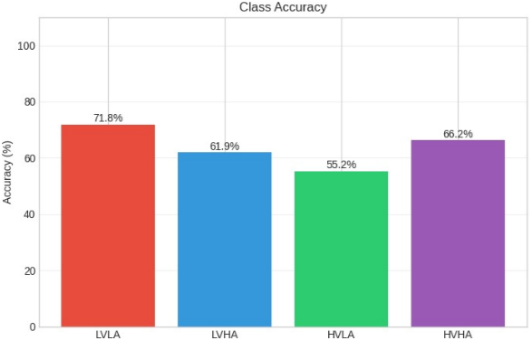
Results
The confusion matrix shows that model effectively distinguishes between four quadrants and is not just guessing the majority class
We achieved our highest accuracy (71.8%) on the LVLA class (Sad/Bored) which is the most critical result for medical use case
The system also performs robustly on HVHA (Happy/Excited) with 66.2% accuracy, meaning it can reliably track positive patient engagement and recovery signs
The matrix reveals that most misclassifications occur between emotions with similar arousal levels
Despite difficulty in distinguishing calm states, high sensitivity to Distress (LVLA) and Excitement (HVHA) proves system is viable for real-world monitoring where catching emotional shifts is key
Class | Precision | Recall | F1-Score
LVLA (Sad/Bored) | 0.67 | 0.72 | 0.69
LVHA (Angry/Fear) | 0.63 | 0.62 | 0.62
HVLA (Calm/Relaxed) | 0.61 | 0.55 | 0.58
HVHA (Happy/Excited) | 0.66 | 0.66 | 0.66

Slide 9
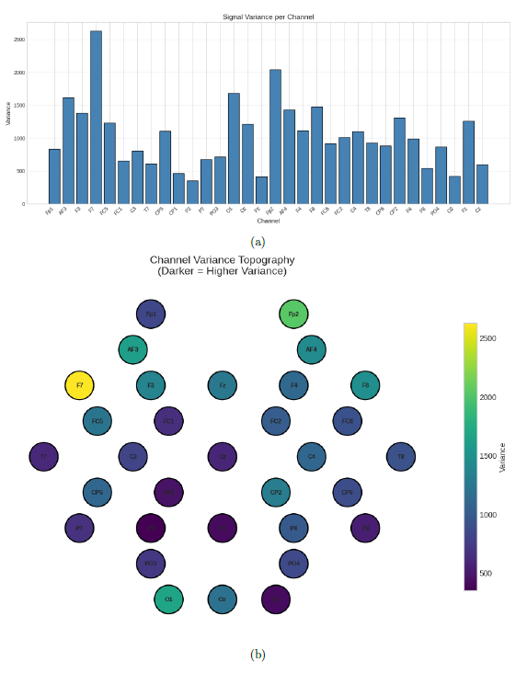
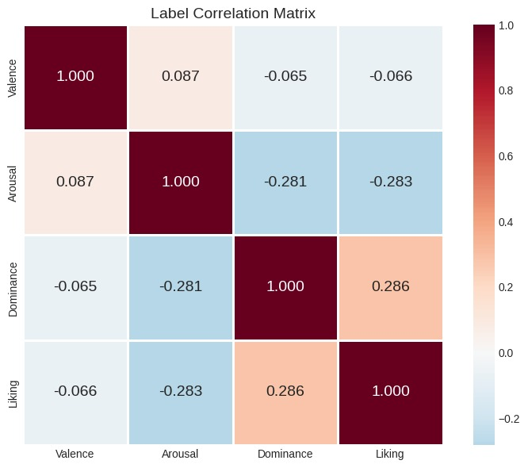
Validation and Meaningfulness
The topographic map reveals the highest signal variance in the Frontal Electrodes (Fp1, Fp2) and Lateral Frontal (F7) regions
This spatial distribution aligns with expected physiological sources, such as frontal cortex activity and ocular artifacts (eye movements), confirming that our model is processing real, active biological signals rather than system noise
The correlation matrix demonstrates a near-zero correlation (0.087) between the two target variables, Valence and Arousal
This low correlation proves that
Valence and Arousal are statistically
distinct dimensions, validating our
architectural decision to treat them
as independent axes to define the 4
emotion classes
(a) Signal Variance per channel
(b) Topographic variance map
Label Correlation Matrix

Slide 10
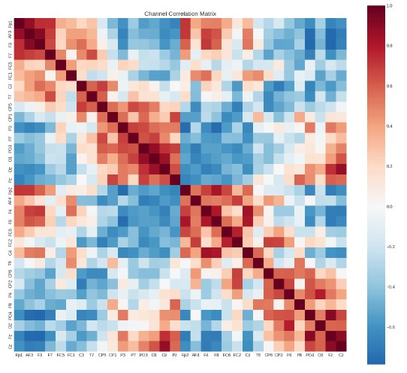
Validation and Meaningfulness
Correlation Matrix for EEG channels

Slide 11
Conclusion
Achieved 64.87% accuracy which is 2.6x better than baseline (25%) using a hybrid CNN-Transformer architecture
Our EDA-driven strategy of using median-based thresholding effectively solved the severe class imbalance found in standard ratings, ensuring unbiased learning across all emotions
Median-based thresholding improves class balance; low Valence-Arousal correlation validates model
Strong performance: 71.8% accuracy for Sadness/Boredom, 66.2% for Happy/Excited states
Validated the model's integrity by confirming the statistical independence of our target labels (Valence/Arousal correlation: 0.087) and verifying physiological signal quality
The next phase of development focuses on optimizing the pipeline for real-time inference, the second development can include subject-independent cross-validation to ensure the system can generalize to new patients immediately without the need for individual training sessions

Slide 12


